Slide 1
Welcome to Open House, Parents!
Ms. Brumleve’s Special Education Class
October 1, 2012

Slide 2
Welcome to My Class!
About me:
My name is Stephanie Brumleve.
I have a major in Special Education and Elementary Education and a minor in Spanish.
I attended John A. Logan College and SIUC.
I have been teaching for 5 years.

Slide 3
My Goals for Open House
To help you as a parent understand what your child will be doing in my class.
To inform you of the classroom rules your child will be expected to follow.
To give you a chance to get to know me and ask me questions.

Slide 4
Classroom Rules
Your child will be expected to follow these rules:
Raise your hand before you speak
Respect yourself and others
Be kind with your words and actions
Work quietly and do not disturb others
Follow directions
Listen carefully
Be positive
Always do your best

Slide 5
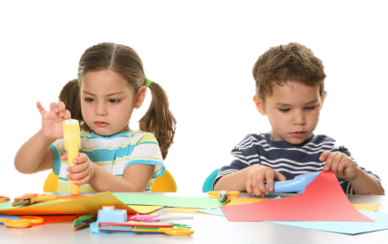
What We Have Been Up To Lately
The past couple of weeks we have been learning all about Fall!
We have had fall spelling words and we have done fall art projects.
We also have been observing different types of leaves. Friday, the kids will be able to present to the class a leaf they have found.

Slide 6
Field Trip!
Next Friday we will be taking a field trip to the Pumpkin Patch. Make sure your child returns their permission slip that is in their take home folder along with $8 for lunch.

Slide 7
What We Will Learn This Year
Math
Addition, Subtraction, Multiplication, Division
Reading
Vowel and Consonant sounds
How to sound out words
Science
Solar System
Animals
Lots of Experiments!
Social Studies
Lewis and Clark
Pilgrims
Indians
This is only a small preview of what we will learn this year. We will learn a lot of other things as well!

Slide 8
Thank You For Coming!
If you have any questions for me, don’t hesitate to ask!
Feel Free to contact me at anytime.
Work Phone: (618)-889-5926 ext. 149
Email: sbrumleve@cels.edu
Have a nice evening!

